Slide 1
JavaScript : Arrays
Sandeep Kaur
Lovely Professional University

Slide 2
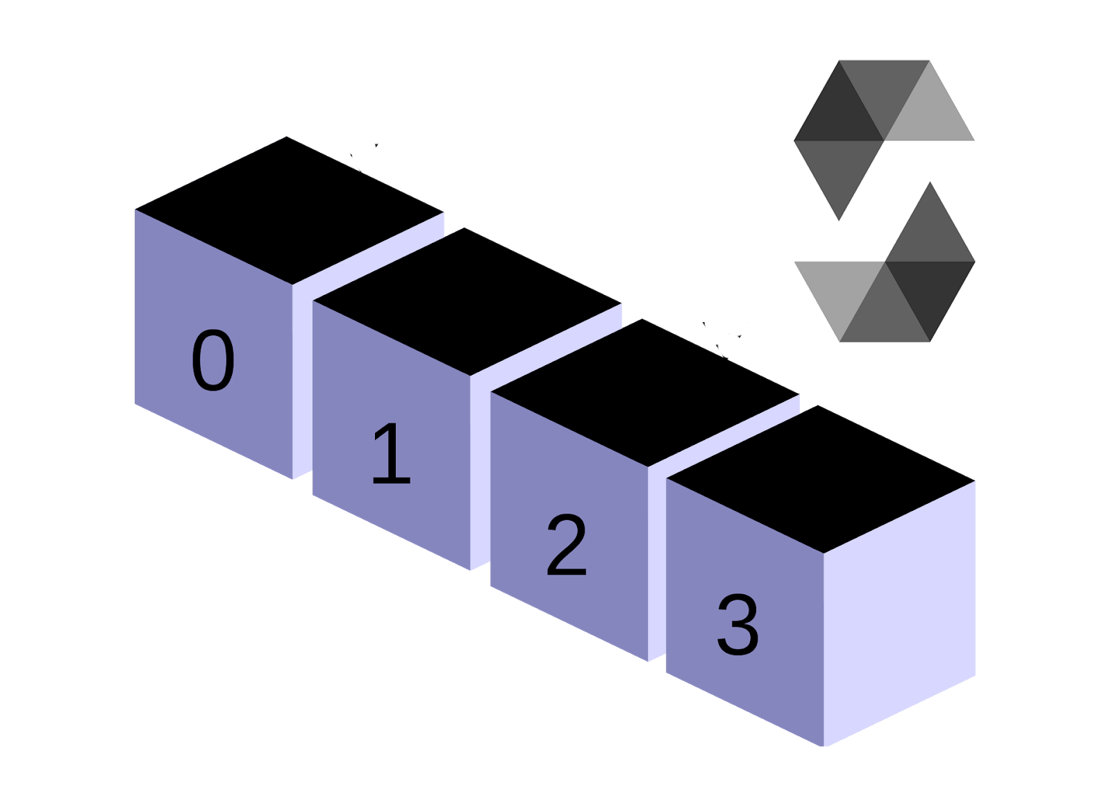


Today’s Learning
What is an
array ?
Array Operations
Array Methods

Slide 3


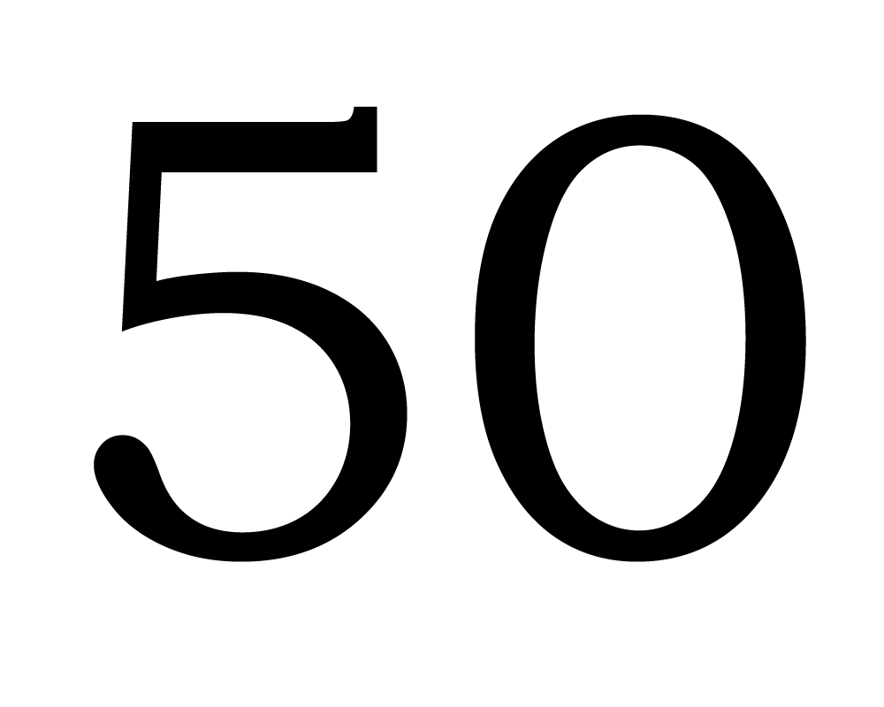

Arrays: Overview
The Array object, as with arrays in other programming languages, enables storing a collection of multiple items under a single variable name, and has members for performing common array operations.
 |  |  | True

Slide 4
Description
JavaScript arrays are resizable and can contain a mix of different data types.
In JavaScript, array elements cannot be accessed using strings as indexes, but must be accessed using integers as indexes.
JavaScript arrays are zero-indexed: the first element of an array is at index 0, the second is at index 1, and so on — and the last element is at the value of the array's length property minus 1.
JavaScript array-copy operations create shallow copies. (All standard built-in copy operations with any JavaScript objects create shallow copies, rather than deep copies).

Slide 5
Array Operations: Create an Array

Slide 6
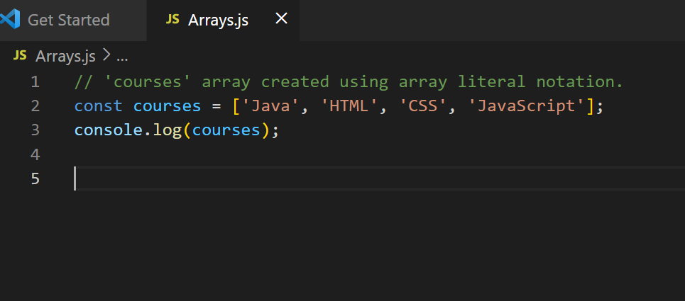
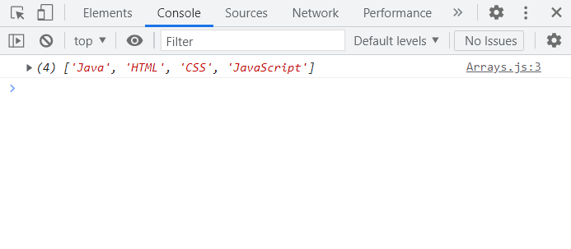
1. Using Array Literal Notation
Creating Arrays using Array Literal Notation
Creating Arrays using Array Literal Notation

Slide 7
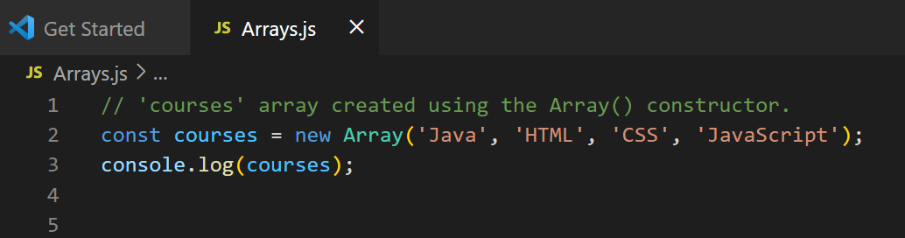
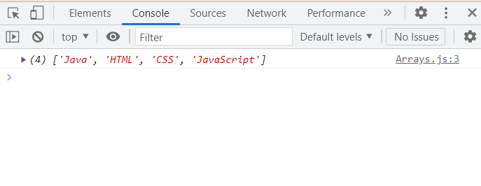
2. Using the Array( ) constructor
Creating Arrays using Array Constructor

Slide 8
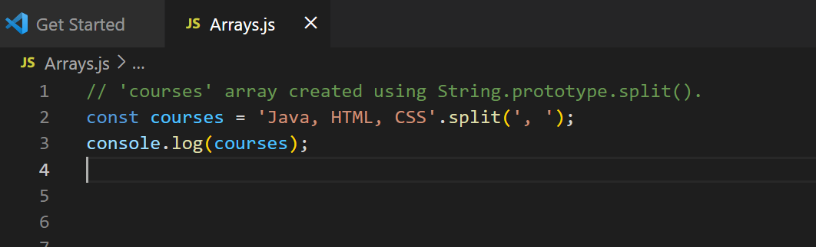
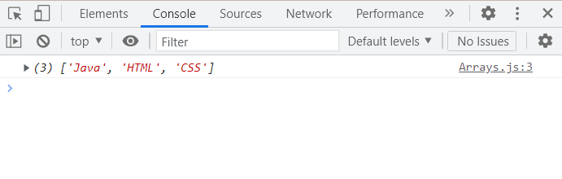
Creating Arrays using String.prototype.split()

Slide 9
Accessing an array item

Slide 10
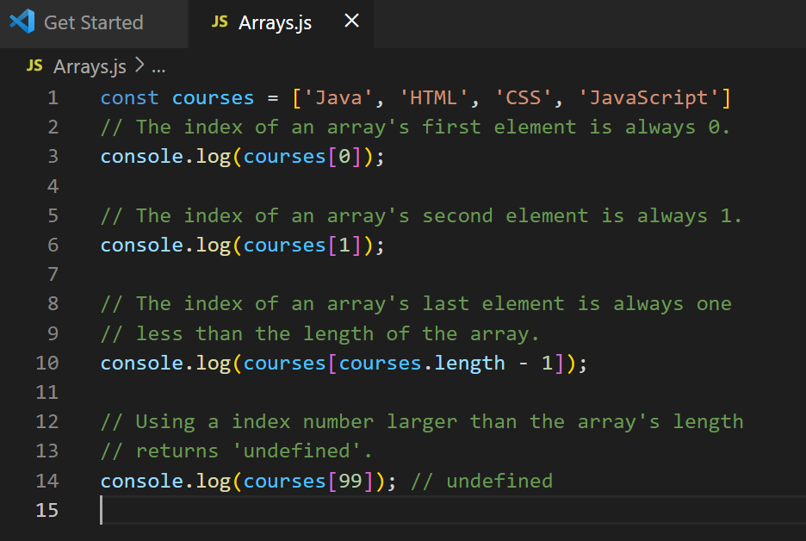
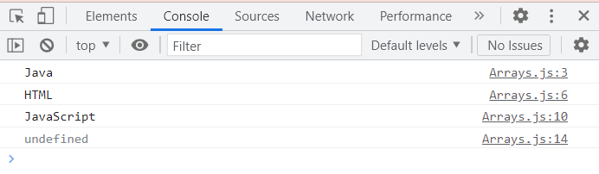
Accessing array item

Slide 11
Find the index of an item in an array
Using indexOf ( )

Slide 12
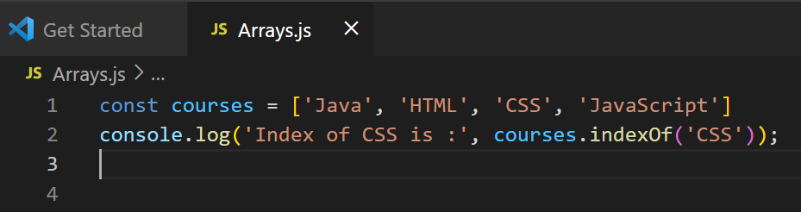
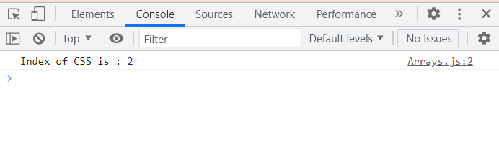

Slide 13
Array Methods: Append an item to an array
Using push( ) method

Slide 14
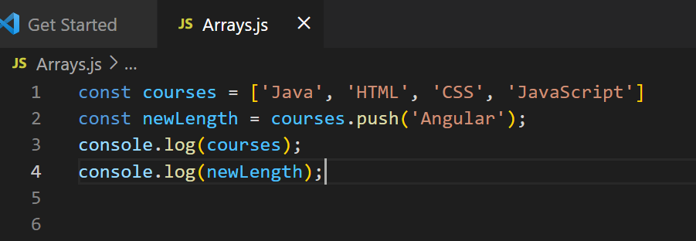
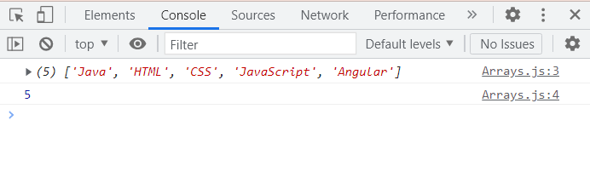

Slide 15
Remove the last item from an array
Using Pop ( ) method

Slide 16
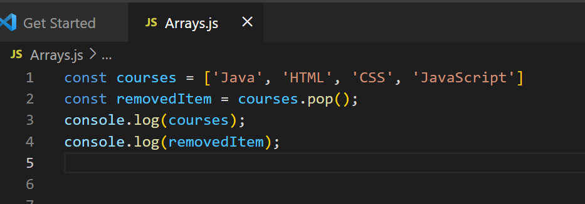
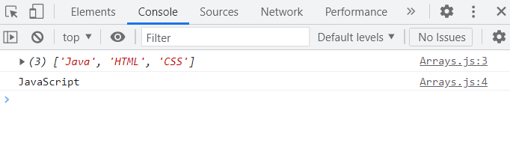

Slide 17
Removing multiple items from the end of an array
Using splice( ) method

Slide 18
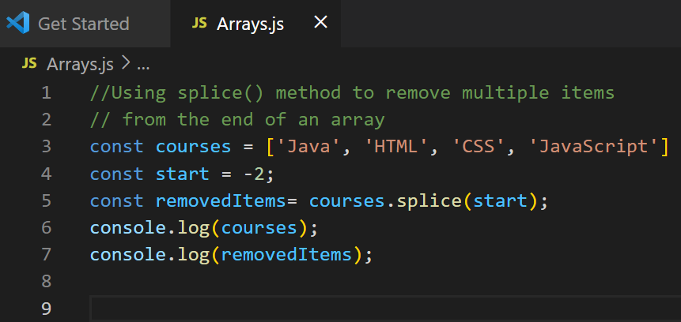
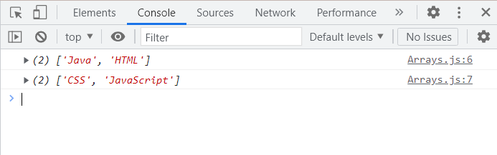

Slide 19
Truncate an array down to first N items
Using splice( )

Slide 20
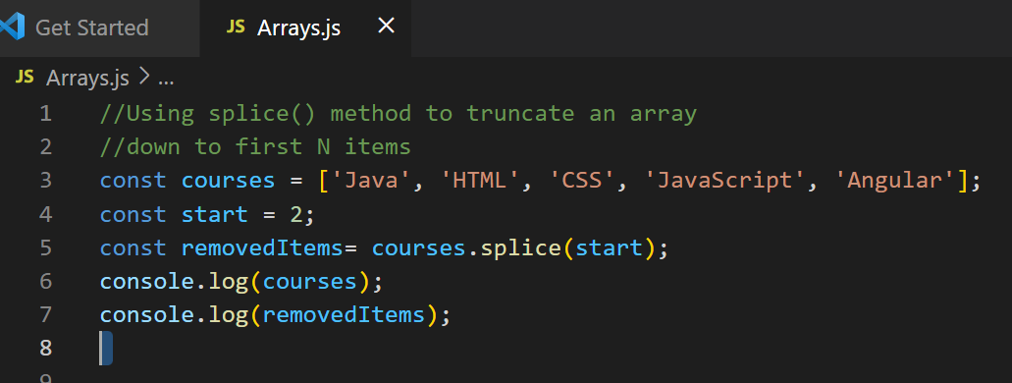
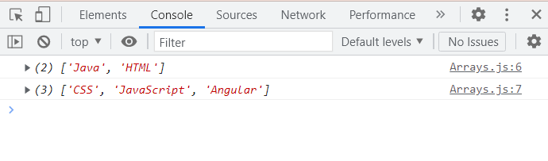

Slide 21
Remove the first item from an array
Using shift( )

Slide 22
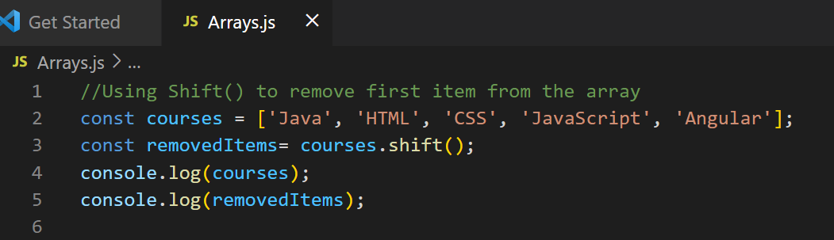
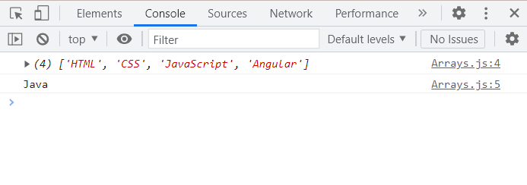

Slide 23
Add an item to the beginning of an array
Using Unshift ( )

Slide 24
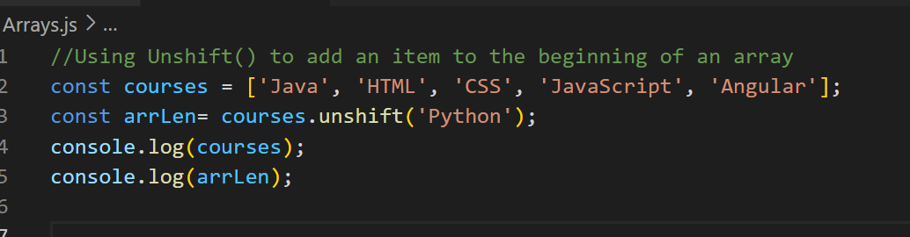
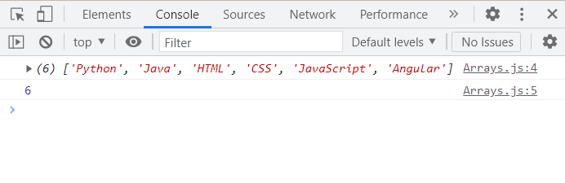

Slide 25
Some More Use cases of Splice : Removing Multiple items from the beginning of an Array
Java | HTML | CSS | JavaScript | Python
const start = 0;
const deleteCount = 3;
courses.splice(start, deleteCount);
console.log(courses);
JavaScript | Python

Slide 26
Some More Use cases of Splice :Remove a single item by index
Java | HTML | CSS | JavaScript | Python
const start = courses.indexOf(‘CSS');
const deleteCount = 1;
courses.splice(start, deleteCount);
console.log(courses);
Java | HTML | JavaScript | Python

Slide 27
Some More Use cases of Splice :Replace multiple items in an array
Java | HTML | CSS | JavaScript | Python
const start = -2;
const deleteCount = 2;
courses.splice(start, deleteCount, ‘Angular’,’React’);
console.log(courses);
Java | HTML | CSS | Angular | React

Slide 28
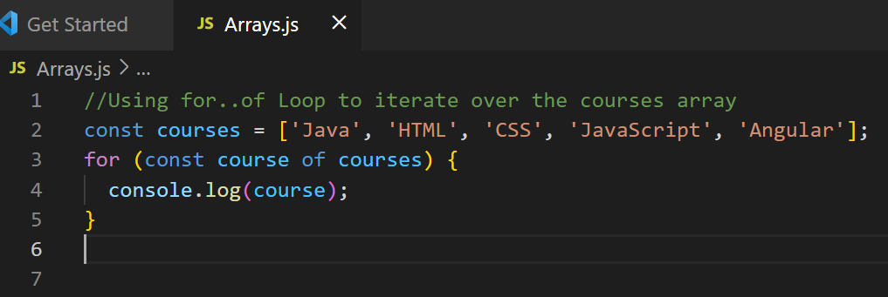
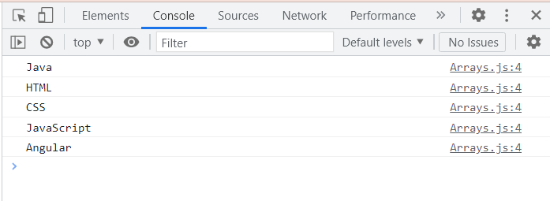
Iterate Over an Array

Slide 29
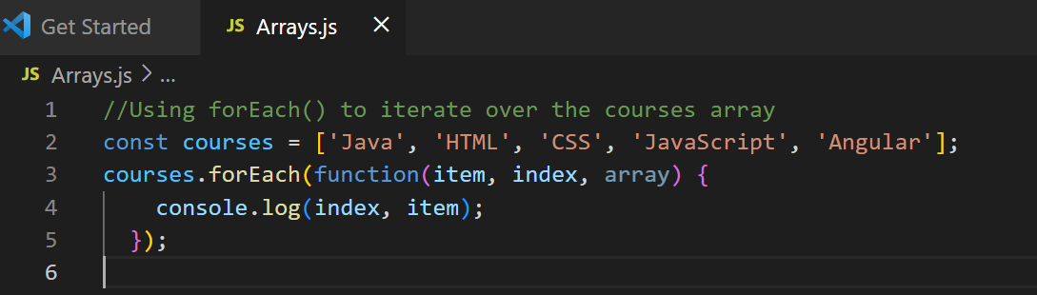
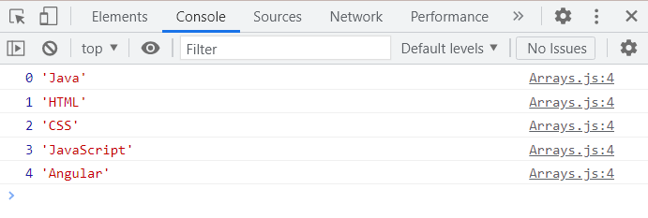
Call a function on each element in an array : Using foreach( ) method

Slide 30
THANK YOU !

